Slide 1


Audio Library
https://github.com/jpvanoosten/Audio
Notes:
In this presentation, you will see how you can integrate the Audio library into your own projects.

Slide 2

Contents
Why?
Download the Audio Library
Generate Build Files
Build
Integrate
Use
Notes:
In this prestation, I will first describe why I wanted to make the Audio library.
I will show you how you can get the source code for the Audio library and build it yourself.
I will also show you how you can integrate the Audio library in your own project and how to use the audio library to play sound effects for your game.

Slide 3

Why?
Minimalistic Audio library
Alternative to OpenAL
Simple interface
No frills
No dependencies
Cross-platform
Built with miniaudio
Notes:
I built the Audio library as a minimalistic audio library for use in simple game frameworks that are used for making 2D games.
When making a simple 2D game, you often don’t need a bloated audio library like OpenAL. Usually, you just want to load a sound effect or background music and play it at the right time.
Other game frameworks like SFML or SDL2 provide an audio library, but it is often difficult to use the audio subsystems from these libraries without pulling in other dependencies.
The Audio library is designed to be simple to use, but at the same time, provide a sufficient amount of functionality to be useable in both 2D and 3D games.
The Audio library is just a C++ wrapper for the miniaudio library. The Audio library provides a simpler interface than miniaudio.

Slide 4

Download
Source code is available on GitHub
Use your favourite Git client, or use the command-line
git clone https://github.com/jpvanoosten/Audio.git
https://1000logos.net/github-logo/
Notes:
To get access to the Audio library, clone the GitHub repo to your local computer using either your favourite Git client or use the command shown on the bottom of the slide to clone the repo to your local computer.

Slide 5
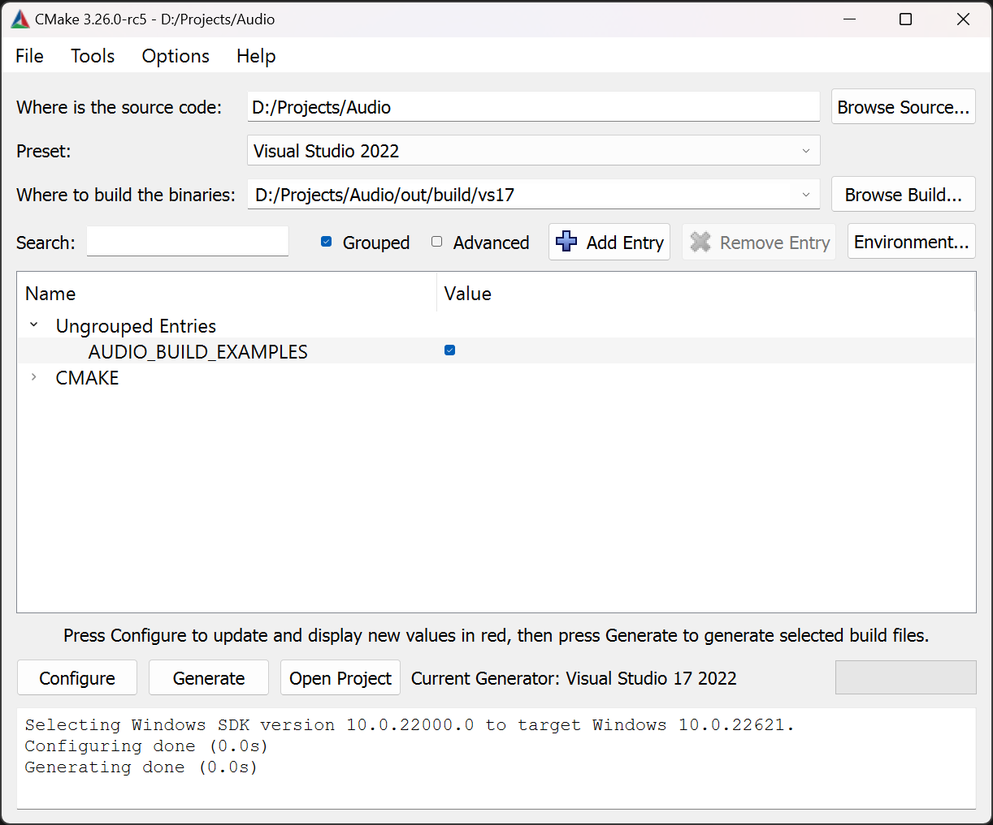
Generate Project Files
Use CMake to generate Visual Studio Project files
Use Visual Studio 2019 or Visual Studio 2022 preset in Cmake
Click Configure > Generate > Open Project
Or use the command-line
1
2
3
cmake -B build
Notes:
You can use CMake GUI to generate the solution and project files for the build toolchain you are using.
The image shown on the slide is using the Visual Studio 2022 preset to generate solution and project files for Visual Studio 2022.
Optionally, you can use the command line to generate the build files for whatever toolchain cmake detects on your system.
The command shown on the bottom of the slide should be run from the root folder of the Audio repository. The build files are placed in a folder called build.
Optionally, you can use the provided GeneratProjectFiles batch file in the project root to generate the Visual Studio solution and project files.

Slide 6
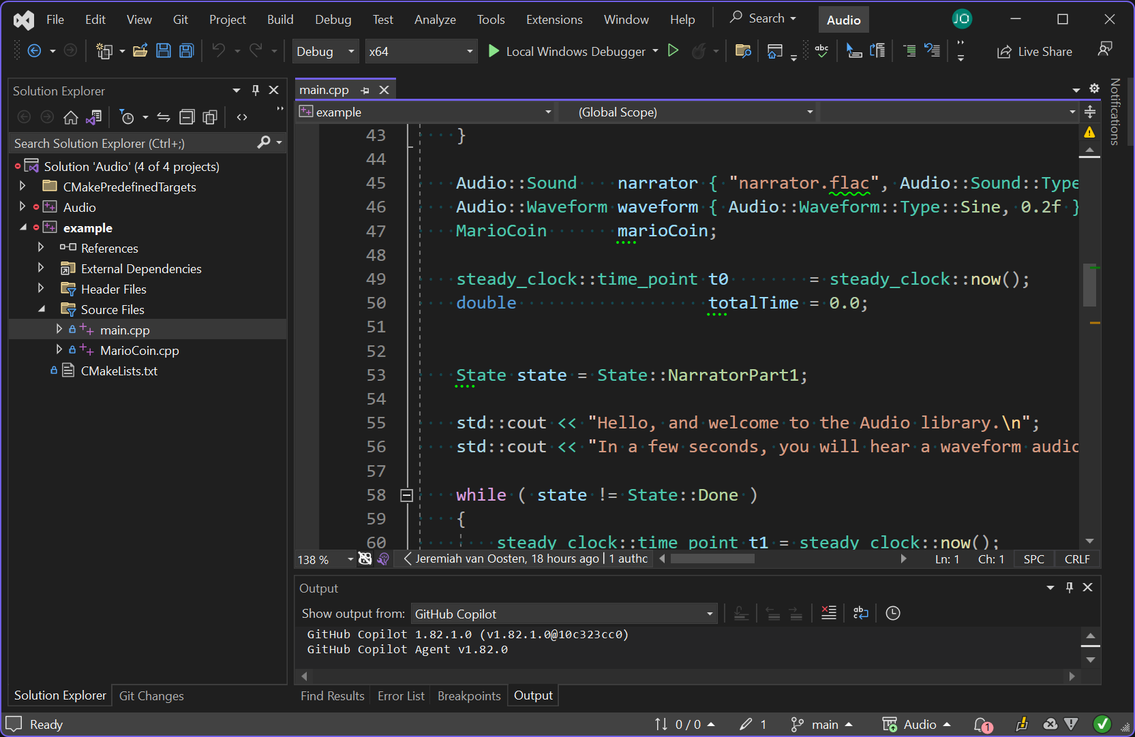
Build
Open the generated solution file in Visual Studio
Build > Build Solution (Ctrl+Shift+B)
Library files go to the lib folder
Binary files go to the bin folder
Notes:
To actually build the library, open the generated Visual Studio solution file and select Build > Build Solution from the main menu.
If everything goes okay, you should be able to run the example project in Visual Studio to test if it is working.
The library files should be placed in the lib folder and the binary files should be placed in the bin folder in the root of the repository.
You should be aware that the library files generated with your version of Visual Studio may not work with other versions of Visual Studio and should not be committed to version control.

Slide 7
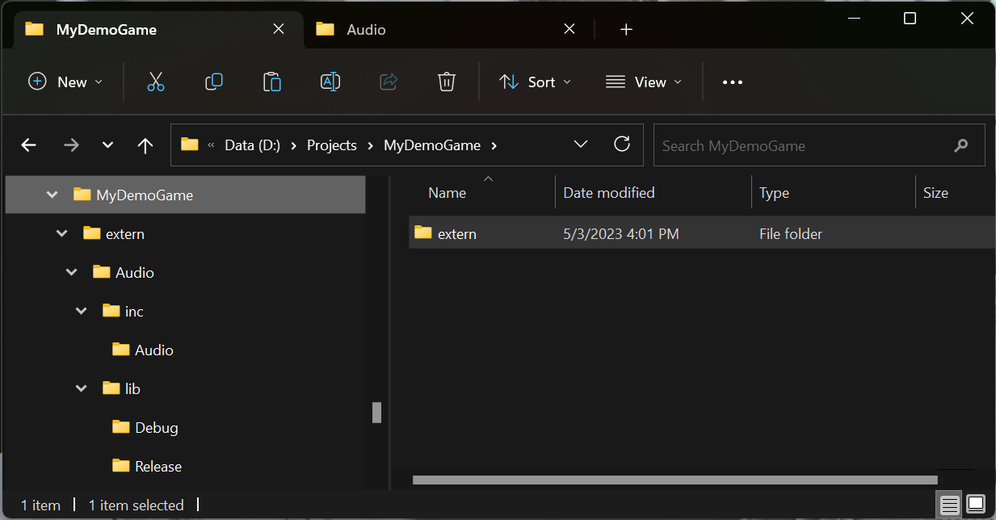
Copy Files
Copy inc and lib folders to your project
For example
  extern/Audio/inc
  extern/Audio/lib
Notes:
To integrate the Audio library into your own project, copy the inc and lib folders to your project.
Generally, I keep external libraries in a folder called extern as shown in the screenshot on this slide.

Slide 8
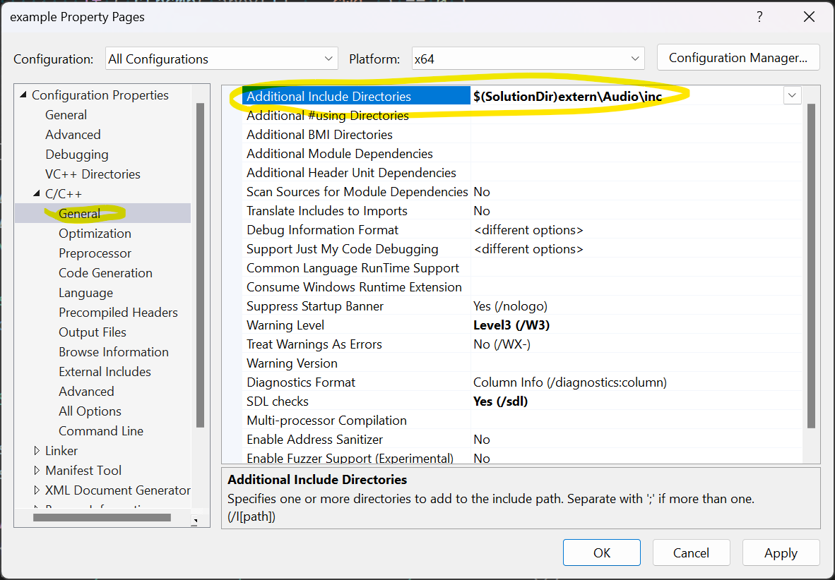
Configure Compiler
Add the extern/Audio/inc folder to your projects Additional Include Directories setting
Notes:
You need to configure the compiler so it can find the header files for the Audio library.
Add the path to the inc folder you copied in the previous step to the Additional Include Directories in your project properties.

Slide 9
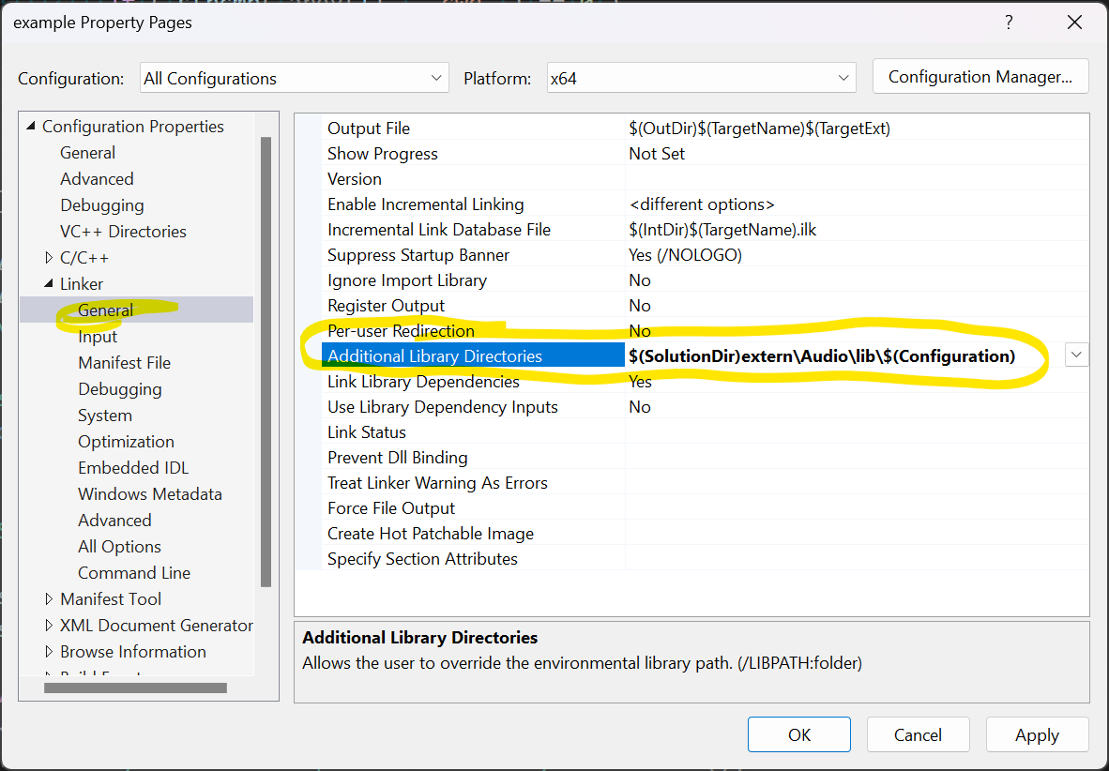
Configure Linker (1)
Add the extern/Audio/lib/$(Configuration) folder to the Additional Library Directories setting
Notes:
You also need to tell the linker where to find the Audio.lib file.
Add the location of the library folder you copied in the previous step to the Additional Library Directories setting in project’s property settings.
The value of the $(Configuration) variable in the path will resolve to Debug when compiling in debug mode and Release when compiling in release mode.

Slide 10
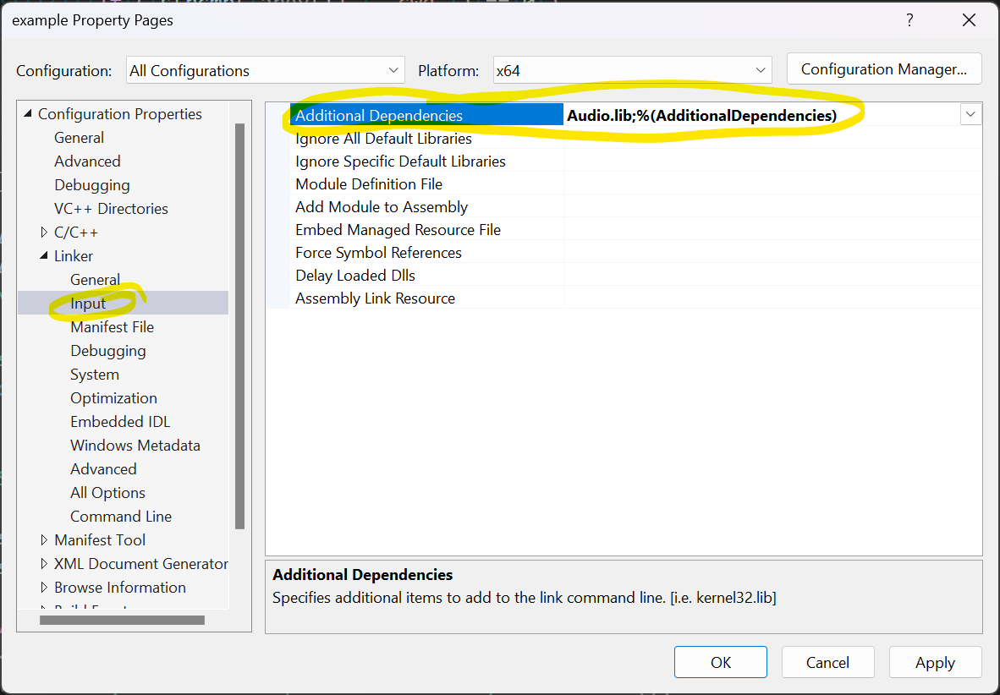
Configure Linker (2)
Add Audio.lib to the Additional Dependencies in the Release configuration
Add Audio_d.lib in the Debug configuration.
Notes:
You also need to specify the name of the library file to link against in the Additional Dependencies setting in your project’s properties.
Use Audio.lib for the Release configuration and Audio_d.lib in the Debug configuration.

Slide 11
Use
#include <Audio/Sound.hpp>
#include <cstdio>
#include <iostream>
int main() {
Audio::Sound coin{ "coin.wav" };
coin.setLooping(true);
coin.play();
std::cout << "Press enter to continue..." << std::endl;
std::ignore = getchar();
coin.stop();
return 0;
}
Notes:
The source code shown here provides an example of using the Audio library.
A coin sound effect is loaded from coin.wav.
The sound effect is set to looping using the setLooping function and the sound effect is played using the play function.
The sound effect will keep playing until it is stopped using the stop function.
Sound effects that are not looping will stop automatically when they have finished playing.

Slide 12

Questions?
https://discord.gg/gsxxaxc
Notes:
If you have any questions about using this library, please don’t hesitate to join our Discord server.

